Slide 1

AI-Powered Secure Chat App:
Chat Buddy
Capstone Project Presentation
Manav Patel 2201201082
Harshil Reddy 2201201043
Rudra Vaidya 2201201117
Internal Guide :- Ms. Niyati Mevada
Drs. Kiran & Pallavi Patel Global University

Slide 2
This presentation will introduce you to a secure messaging platform designed to revolutionize communication with its enhanced security, intelligent features, and seamless user experience.
Purpose of ChatBuddy
ChatBuddy is designed to provide users with a modern, secure, and intelligent messaging platform. It aims to enhance traditional real-time chat applications by integrating AI-powered features and strong end-to-end encryption, ensuring both a smarter and safer communication experience. It supports instant communication, personalized user interactions, and privacy-focused local AI processing

Slide 3
Unique Features of ChatBuddy
AI-Enhanced Messaging
Smart replies generated using local AI models
Chat summarization to help users quickly catch up
Sentiment analysis for emotion-aware communication
End-to-End Encryption
Hybrid RSA + AES encryption for secure messaging
Secure authentication with JWT and password hashing
Real-Time Communication
Instant message delivery with Socket.io
Online status indicators and read receipts
Modern UI/UX
Responsive, customizable interface using React, TailwindCSS, and DaisyUI
Dark/light mode, emoji support, and media sharing

Slide 4
Challenges of Traditional Messaging Apps
Privacy Concerns
Limited Features
Traditional messaging apps often fall short in safeguarding user privacy. Data breaches and lack of end-to-end encryption expose sensitive conversations to potential vulnerabilities.
Many messaging apps lack innovative features such as AI-powered chat assistance, sentiment analysis, and smart replies, leading to a less efficient and personalized experience.

Slide 5
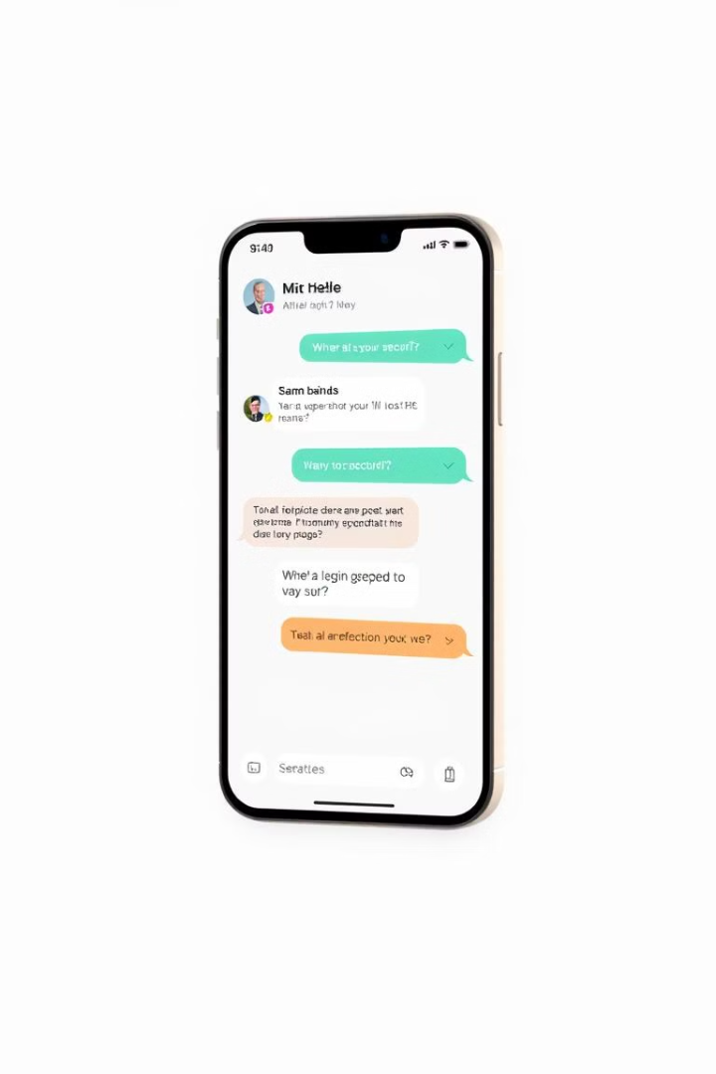
Introducing Our AI-Powered Secure Chat App
Secure
Intelligent
Our app prioritizes user privacy with robust end-to-end encryption, ensuring that only authorized individuals can access conversations.
Powered by advanced AI technology, our platform provides smart replies, sentiment analysis, and chat summarization to enhance communication efficiency.
Intuitive
Our user-friendly interface and intuitive navigation make the app accessible to all users, regardless of their technical expertise.

Slide 6
End-to-End Encryption
What is E2EE?
End-to-End Encryption ensures that only the sender and receiver can read the messages.
No one else—not even the server—can access the message content.
How it works in ChatBuddy:
AES (Advanced Encryption Standard): Used for fast encryption of message content.
RSA (Rivest–Shamir–Adleman): Used to securely share the AES key between users.
Message Flow:
User A encrypts message with AES key.
AES key is encrypted with User B’s RSA public key.
Only User B can decrypt the AES key with their private RSA key.
Decrypted AES key is used to decrypt the message.

Slide 7
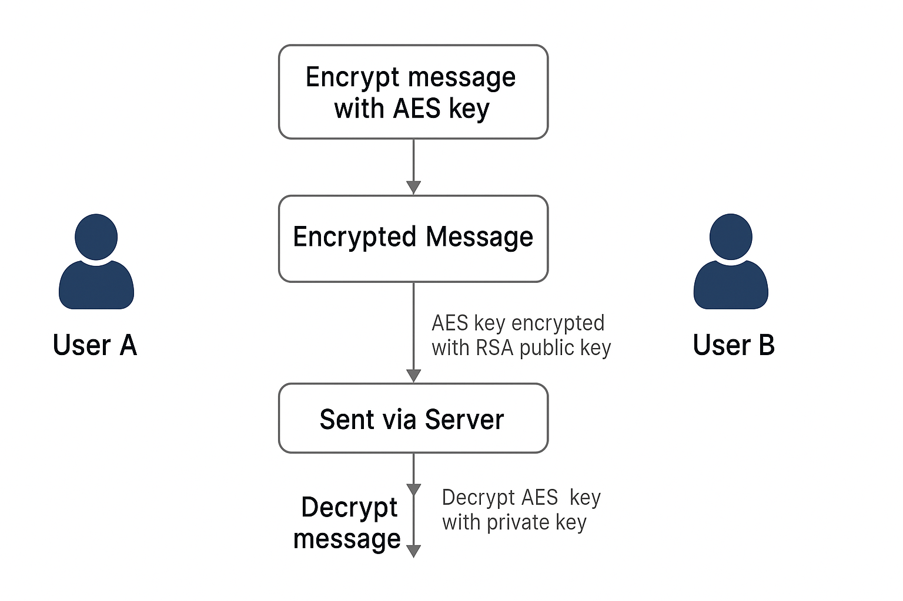

Slide 8

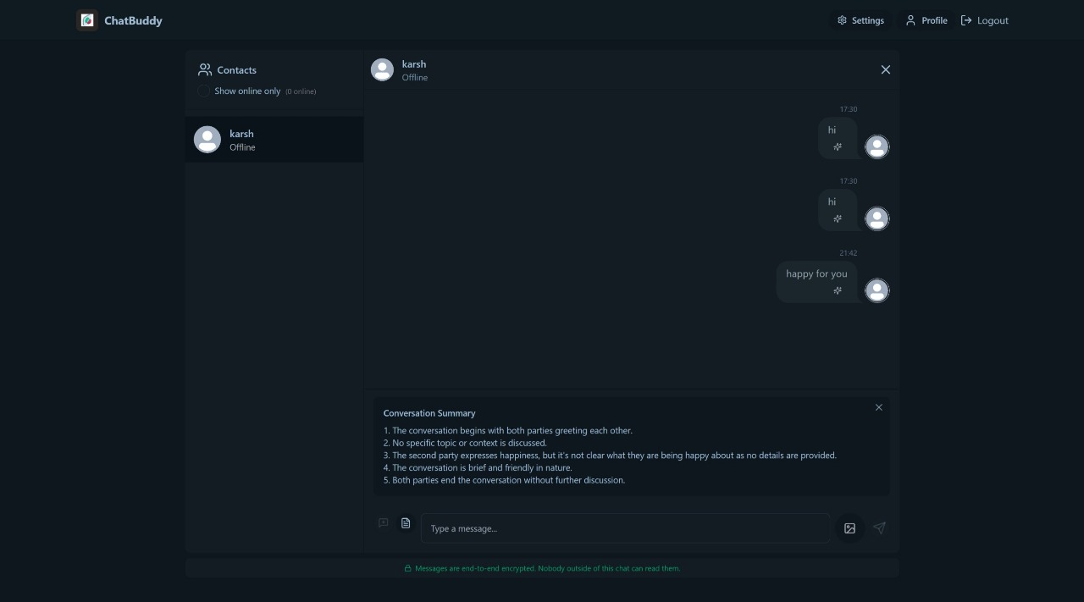
AI-Driven Chat Assistance
Chat Summarization
The AI summarizes long conversations, providing a quick overview of key points.

Slide 9

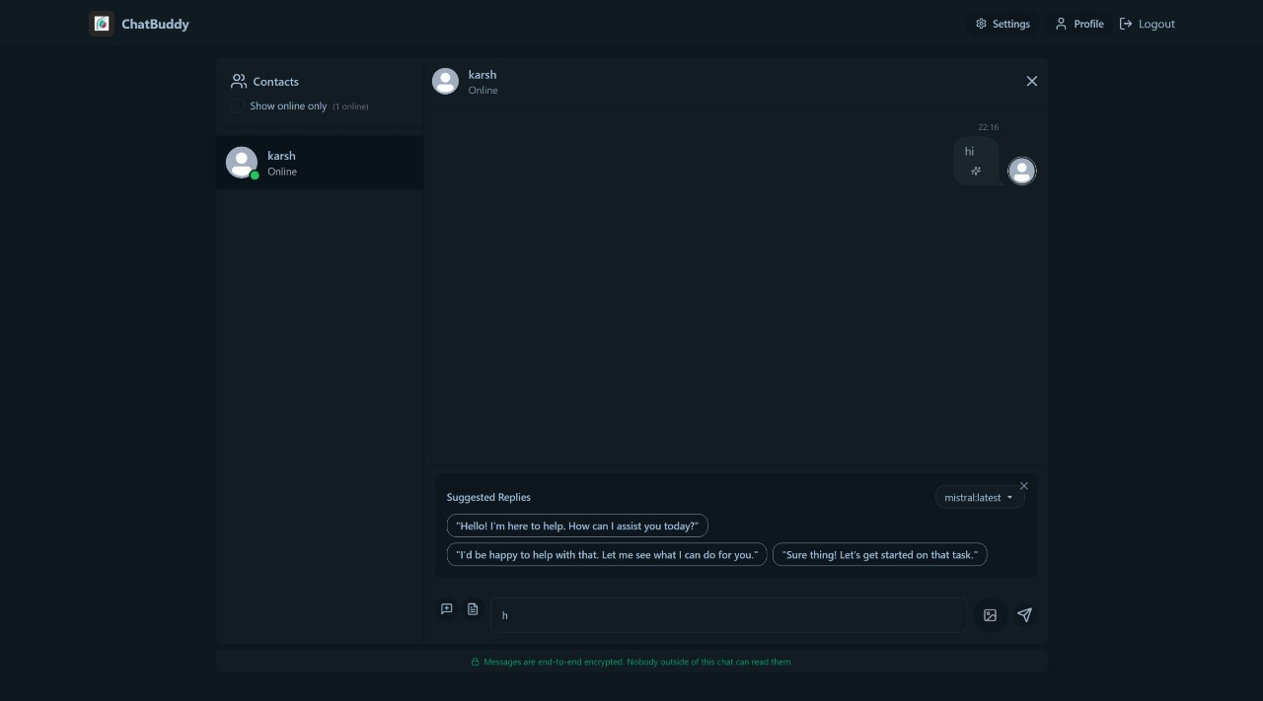
Smart Replies
The AI engine analyzes conversations and offers appropriate responses, saving time and effort.

Slide 10

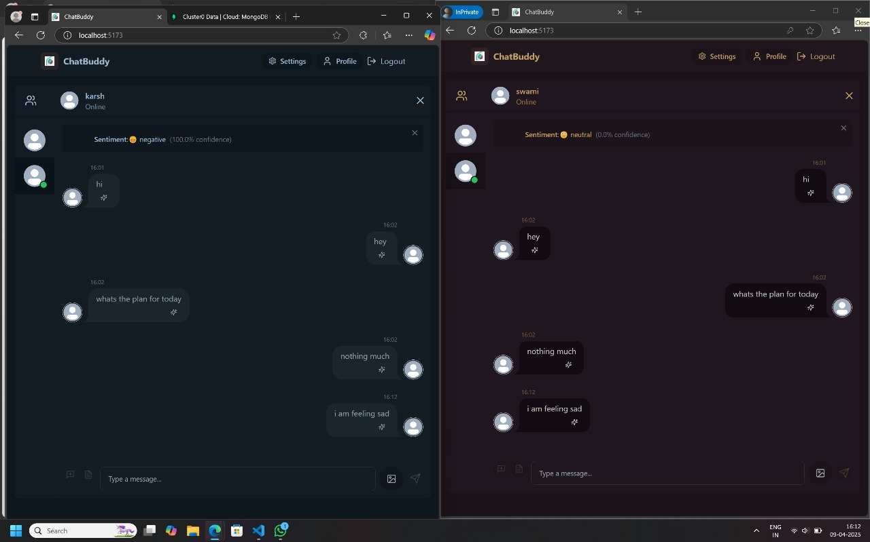
Sentiment Analysis
The AI detects emotional tones in messages, helping users understand the intent behind each message.

Slide 11

Seamless User Experience
Responsive UI
The app seamlessly adapts to various screen sizes and resolutions for a consistent experience across devices.
Effortless Navigation
Intuitive menu structures and gesture-based controls simplify navigation, allowing users to easily access features.
Customization
Users can personalize their experience with theme options, notification settings, and custom chat backgrounds.

Slide 12
Cross-Platform Compatibility: React Native
React Native
Unified Experience
React Native allows us to build a single codebase for both iOS and Android platforms, ensuring a unified user experience.
Users can seamlessly switch between their mobile and desktop devices without experiencing any disruptions or inconsistencies.

Slide 13
Key Technologies
Frontend
React: Modern UI library for building the user interface
TailwindCSS & DaisyUI: For responsive and attractive styling
Zustand: Lightweight state management solution
Socket.io Client: For real-time communication
React Router: For application routing
Emoji Picker: For emoji integration in messages
Vite: Fast build tool and development server

Slide 14
Backend
Node.js & Express: Server-side JavaScript runtime and framework
MongoDB: NoSQL database for storing user data and messages
Socket.io: Real-time bidirectional event-based communication
JWT: JSON Web Tokens for authentication and authorization
Ollama: Local AI model integration for smart features
Sentiment Analysis: Using both local and Hugging Face models
Cloudinary: Cloud storage for user profile images and attachments

Slide 15
AI Features
Smart Replies: AI-generated contextual reply suggestions
Conversation Summarization: AI-powered chat summarization
Sentiment Analysis: Emotion detection in messages
Local AI Models: Integration with Ollama for privacy-focused AI processing
Mistral model for general AI tasks
WizardLM2 model for enhanced capabilities

Slide 16
Security Features
End-to-End Encryption: Using RSA and AES encryption
JWT Authentication: Secure user authentication
Password Hashing: Using bcrypt for secure password storage
Application Features
User Experience
Real-time messaging with instant delivery
Online user status indicators
Message read receipts
User profiles with customizable avatars
File and image sharing capabilities Emoji support in messages
Dark/Light theme options

Slide 17

Advanced Security Features
Two-Factor Authentication
Device Management
The app allows users to remotely control access from multiple devices and revoke unauthorized access.
Users can enhance security by requiring an additional verification code upon login.
Logging
All user activity is securely logged, ensuring accountability and traceability.

Slide 18
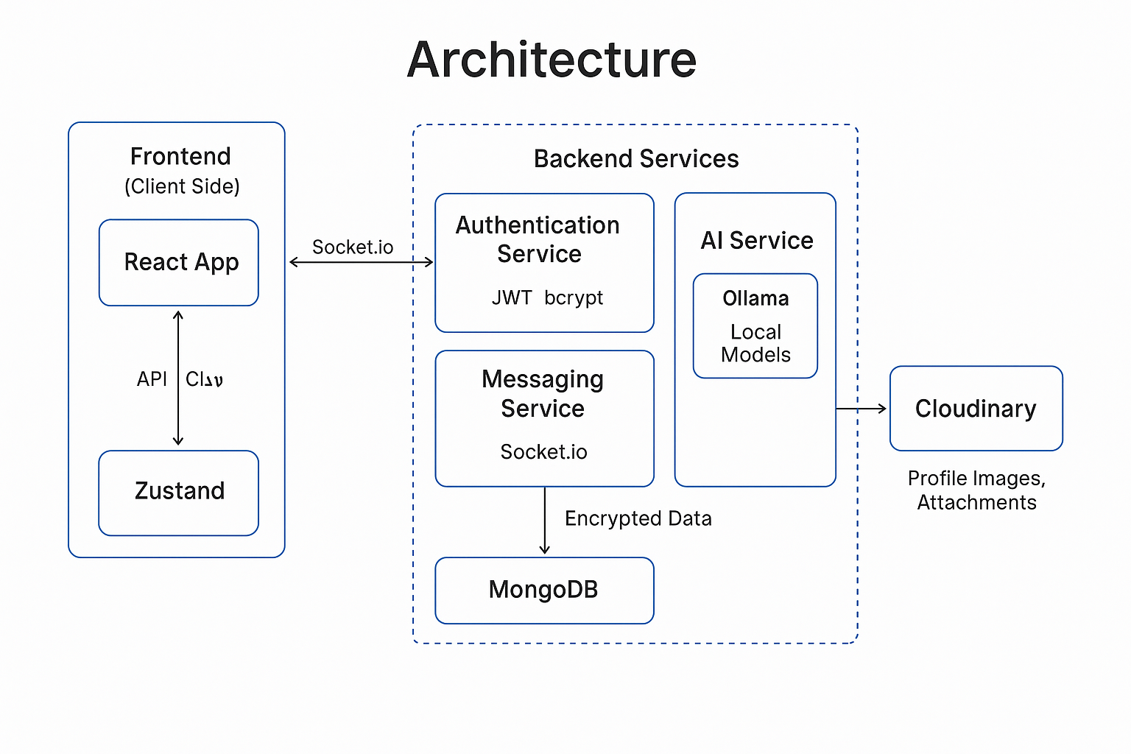
Architecture
Frontend (React App)
Built with React, TailwindCSS, and Zustand.
Communicates with backend services via API and real-time Socket.io.
Backend
Authentication Service Handles user login, registration, JWT token generation, and password hashing.
Messaging Service Manages real-time messaging, user presence, and message storage in MongoDB.
AI Service Uses Ollama to run local AI models (Mistral, WizardLM2) for smart replies, summarization, and sentiment analysis.
Real-Time Communication
Achieved using Socket.io between the frontend and messaging service for instant updates.
Database Layer
MongoDB stores user data, message logs, and metadata.
Ensures scalability and efficient data retrieval.
Security Layer
Implements RSA + AES encryption for secure end-to-end messaging.
Uses JWT for secure authentication.
Cloud Integration
Cloudinary is used to store user profile images and media attachments securely.

Slide 19

The Future Enhancements
Voice and video chat capabilities
Group chat functionality
Advanced AI features like translation and content moderation
Mobile application development

